Slide 1
Intelligent Agents
Artificial Intelligence / Applied Artificial Intelligence
1

Slide 2
Outline
Agents and environments
PEAS (Performance measure, Environment, Actuators, Sensors)
Environment types
Agent types

Slide 3
Agents and environments
Agent
Sensors
Percepts
?
Environment
Actuators
Actions
Agents include humans, robots, softbots, thermostats, etc.
The agent function maps from percept histories to actions:
f : P∗ → A
The agent program runs on the physical architecture to produce f

Slide 4







Vacuum-cleaner world
A B
Percepts: location and contents, e.g., [A, Dirty]
Actions: Left, Right, Suck, NoOp

Slide 5
A vacuum-cleaner agent
Percept sequence | Action
[A, Clean] | Right
[A, Dirty] | Suck
[B, Clean] | Left
[B, Dirty] | Suck
[A, Clean], [A, Clean] | Right
[A, Clean], [A, Dirty] | Suck
. | .
function Reflex-Vacuum-Agent( [location,status]) returns an action
if status = Dirty then return Suck else if location = A then return Right else if location = B then return Left
What is the right function?
Can it be implemented in a small agent program?

Slide 6
PEAS
To design a rational agent, we must specify the task environment
Consider, e.g., the task of designing an automated taxi: Performance measure??
Environment?? Actuators??
Sensors??

Slide 7
PEAS
To design a rational agent, we must specify the task environment
Consider, e.g., the task of designing an automated taxi:
Performance measure?? safety, destination, profits, legality, comfort, . . .
Environment?? US streets/freeways, traffic, pedestrians, weather, . . .
Actuators?? steering, accelerator, brake, horn, speaker/display, . . .
Sensors?? video, accelerometers, gauges, engine sensors, keyboard, GPS, . . .

Slide 8
Internet shopping agent
Performance measure??
Environment?? Actuators??
Sensors??

Slide 9
Internet shopping agent
Performance measure?? price, quality, appropriateness, efficiency
Environment?? current and future WWW sites, vendors, shippers Actuators?? display to user, follow URL, fill in form
Sensors?? HTML pages (text, graphics, scripts)

Slide 10
Environment types
Fully Observable vs. Partially Observable Environments
Fully Observable: Agent’s sensors provide complete state information at all times.
Convenience: No need for internal state tracking.
Partially Observable: Limited or noisy sensor data, missing state information.
Examples:
Fully Observable: Chessboard (all pieces visible).
Partially Observable: Vacuum agent with local dirt sensor, self-driving car unable to see driver intentions.
Unobservable: No sensor input; still, goals may sometimes be achievable.

Slide 11
Environment types
Single Agent vs. Multiagent Environments
Single-Agent: Only one agent optimizing its performance (e.g., solving a crossword puzzle).
Multiagent: Multiple agents whose actions impact each other (e.g., chess, taxi driving).
Key Distinction: Does another entity maximize its performance based on the agent’s behaviour?
Types of Multiagent Environments:
Competitive: Agents have opposing goals (e.g., chess).
Cooperative: Agents share goals (e.g., avoiding collisions in traffic).
Mixed: Both cooperative and competitive elements (e.g., competing for parking spaces).
Challenges in Multiagent Systems:
Need for communication in cooperative settings.
Randomized behaviour can prevent predictability in competitive scenarios.

Slide 12
Environment types
Deterministic vs. Stochastic Environments
Deterministic: The next state is fully determined by the current state and agent’s action.
Stochastic: The next state has uncertainty, often modeled with probabilities.
Fully Observable & Deterministic: No uncertainty for the agent.
Partially Observable Environments: May appear stochastic due to missing information.
Examples:
Deterministic: Classic vacuum world (fixed dirt and reliable suction).
Stochastic: Taxi driving (unpredictable traffic, tire blowouts).
Uncertain Environments: Either partially observable or non-deterministic.
Nondeterministic vs. Stochastic: Nondeterministic environments specify possible outcomes but not probabilities.

Slide 13
Environment types
Episodic vs. Sequential Environments
Episodic: The agent’s experience is divided into independent episodes.
Each episode consists of a percept and a single action.
Past actions do not affect future episodes.
Example: Detecting defective parts on an assembly line.
Sequential: The current decision impacts future decisions.
Actions have long-term consequences.
Examples: Chess, taxi driving.
Complexity: Episodic environments are simpler as they don’t require planning ahead.

Slide 14
Environment types
Static vs. Dynamic Environments
Static Environment
No changes unless the agent acts.
Predictable and stable.
Lower complexity.
Example: Chessboard (positions remain fixed until a move is made).
Dynamic Environment
Changes occur autonomously.
Unpredictable and uncertain.
Requires continuous adaptation.
Higher complexity.
Example: Traffic conditions (affected by accidents, construction, rush hour).

Slide 15
Environment types
Discrete vs. Continuous Environments
Discrete Environment:
Finite number of distinct states.
Time, percepts, and actions occur in discrete steps.
Example: Chess (finite board positions and moves).
Continuous Environment:
Infinite possible states and smooth transitions over time.
Percepts and actions vary continuously.
Example: Taxi driving (speed, location, and steering angles change smoothly).

Slide 16
Environment types
The environment type largely determines the agent design
The real world is (of course) partially observable, stochastic, sequential, dynamic, continuous, multi-agent

Slide 17
Agent types
Four basic types in order of increasing generality:
simple reflex agents
reflex agents with state
goal-based agents
utility-based agents
All these can be turned into learning agents

Slide 18
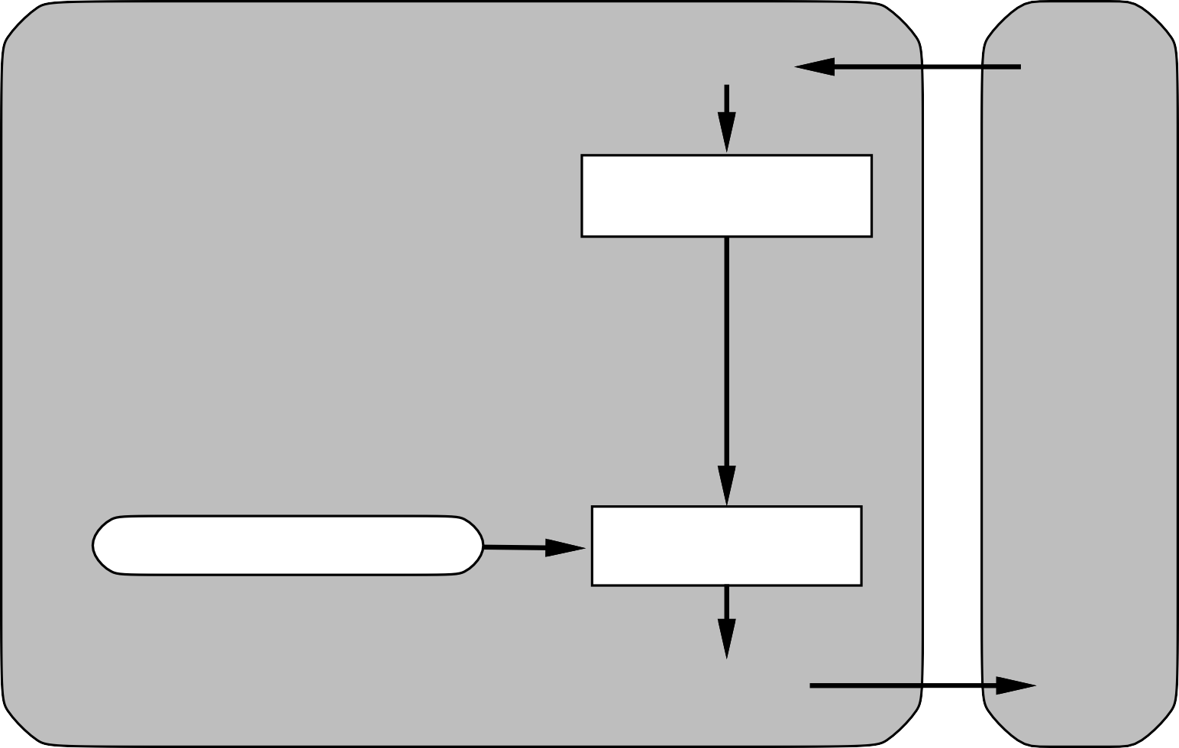
Simple reflex agents
Agent
Sensors
What the world is like now
Environment
Condition-action rules
What action I should do now
Actuators

Slide 19
Example
function Reflex-Vacuum-Agent( [location,status]) returns an action
if status = Dirty then return Suck else if location = A then return Right else if location = B then return Left

Slide 20
Problems with simple reflex agents
Simple reflex agents fail in partially observable environments
E.g., suppose location sensor is missing
Agent (presumably) Sucks if Dirty; what if Clean?
⇒ infinite loops are unavoidable
Randomization helps (why??), but not that much

Slide 21
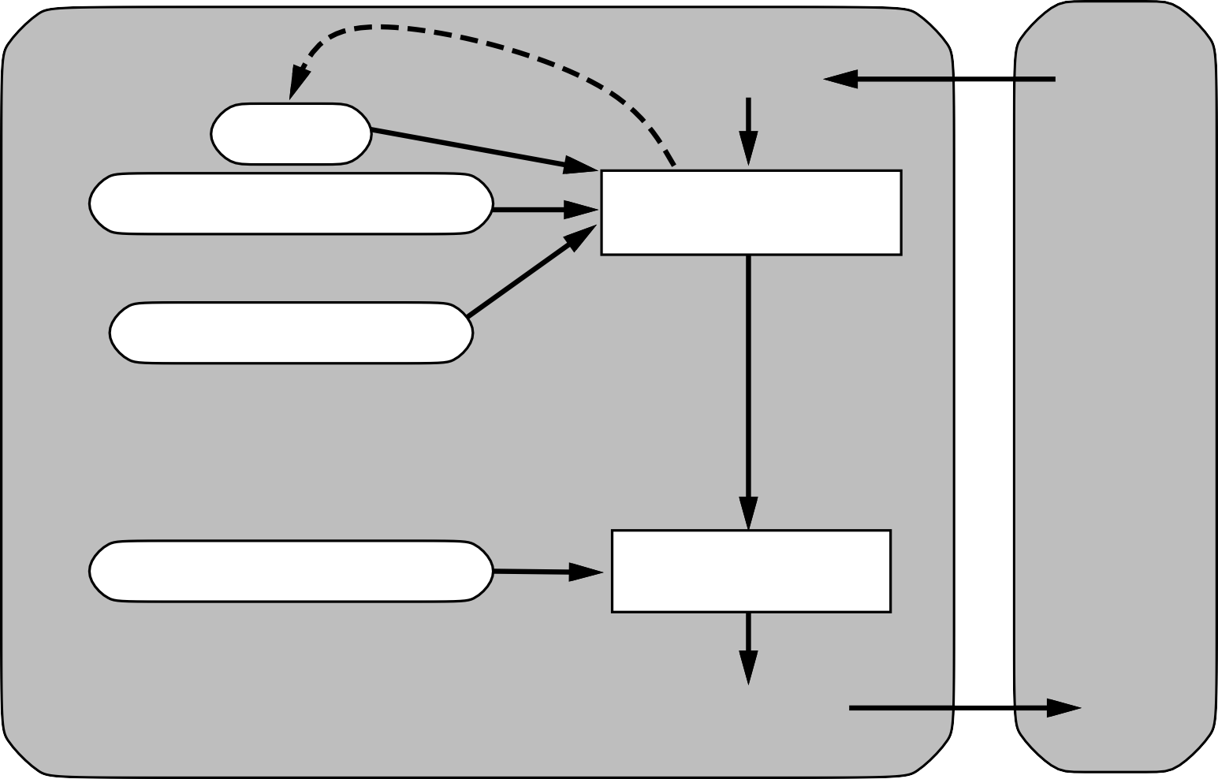
Reflex agents with state
Sensors
State
How the world evolves
What the world is like now
Environment
What my actions do
Condition-action rules
What action I should do now
Agent
Actuators

Slide 22
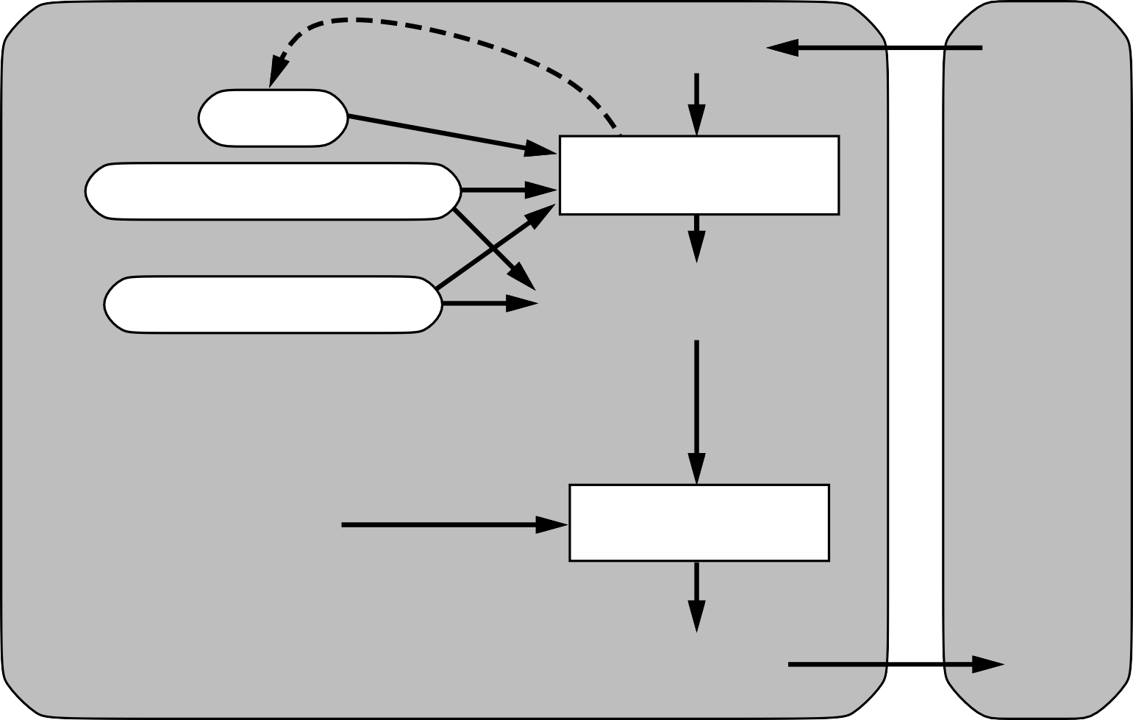
Goal-based agents
Sensors
State
What the world is like now
How the world evolves
Environment
What my actions do
What it will be like if I do action A
Goals
What action I should do now
Agent
Actuators

Slide 23
Utility-based agents
Sensors
State
What the world is like now
How the world evolves
Environment
What my actions do
What it will be like if I do action A
Utility
How happy I will be in such a state
What action I should do now
Agent
Actuators

Slide 24
Summary
Agents interact with environments through actuators and sensors
The agent function describes what the agent does in all circumstances The performance measure evaluates the environment sequence
A perfectly rational agent maximizes expected performance Agent programs implement (some) agent functions
PEAS descriptions define task environments Environments are categorized along several dimensions:
observable? deterministic? episodic? static? discrete? single-agent?
Several basic agent architectures exist:
reflex, reflex with state, goal-based, utility-based

